Slide 1

A wind tunnel for kids…
Status Update
September 8, 2011

Slide 2
Activities this week
Brought consultant on board
Jim Masters, recent PhD grad of Univ. of Tennessee Chattanooga SimCenter
Donated his 2D Fluid Dynamics Solver from PhD course work
Initiated requirements gathering
Use case driven
In terms of exhibit flow

Slide 3
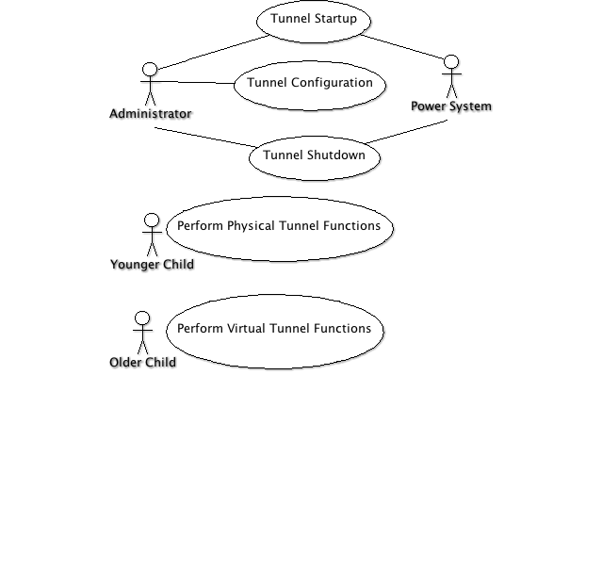
Use Case Model

Slide 4
Use Case Detail - Tunnel Administrator
Use case: Tunnel Startup
Administrator powers on the system
System automatically initializes, turns on all displays, and begins waiting for user commands
Use case: Tunnel Configuration
Administrator specifies desired sensors, actuators, etc. and assigns each to an input or output channel
Administrator calibrates tunnel
Administrator tests tunnel sensors, actuators, etc.
Use case: Tunnel Shutdown
System receives shutdown command and initiates tunnel shutdown equivalent to pressing the "big red button."

Slide 5
Use Case Detail - Tunnel Visitor
Use case: Perform Physical Tunnel Functions
User approaches tunnel
User tweaks tunnel parameters
Air speed, tunnel speed, temperature, ...
User presses big green go button
System responds by starting up
User presses big red stop button
System responds by shutting down the tunnel
User presses tunnel tweet button
System sends tweet with important result characteristics
Use case: Perform Virtual Tunnel Functions
User selects a virtual model shape
User tweaks simulation parameters
User presses big green go button
System computes flow solution
System shows result of simulation
System tweets result of simulation

Slide 6

Follow us on Twitter…
@TunnelK

